Slide 1
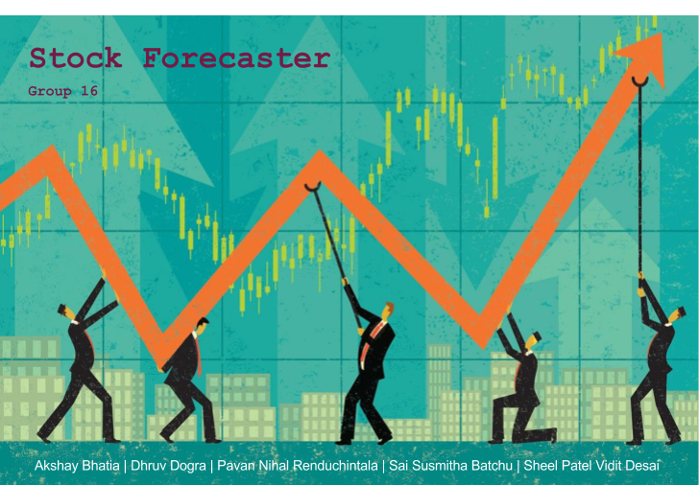

Slide 2
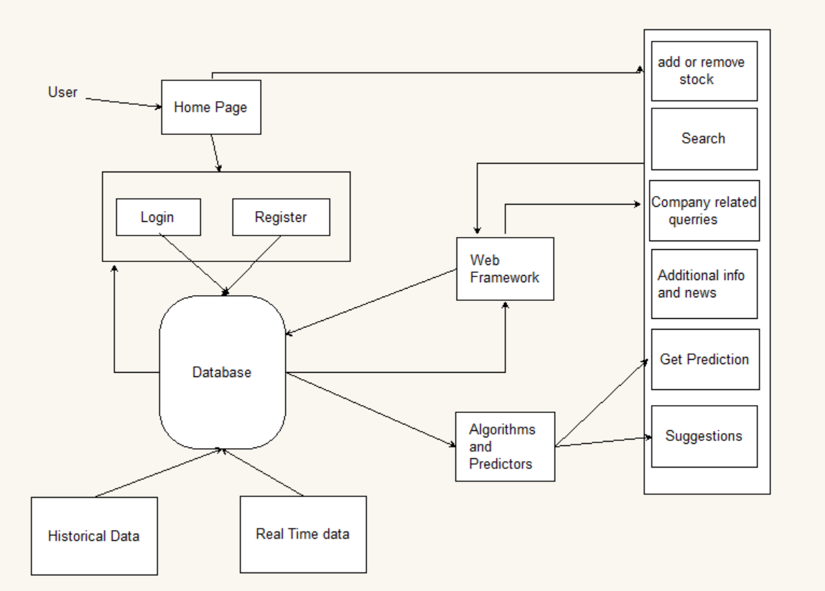
System Architecture

Slide 3
Use Cases
UC-1: Register - Allow a visitors to fill out the a registration form and become a user.
UC-2: Login - Allows user to access their account and view information for their tracked stocks.
UC-3: Search Stock - User can search for a particular stock through keywords.
UC-4: Add Stock - Allows user to add new stocks to his portfolio.
UC-5: Sell Stock - Sell stocks from the portfolio.
UC-6: Predict Actions - system gives the best possible suggestion the registered user
UC-7: Display Chart - Output a chart showing movement of the stock over a long period of time. User can then check stock values at different time.
UC-8: Display Portfolio Chart - Output detailed portfolio graph detailing movements of personal stocks.
UC-9: Show Stock Related News - Users will have access to current events and news regarding for the given stocks in the portfolio.
UC-10: Logout - Allow users to log out of the system.

Slide 4
Special Features
Portfolio Graph
News
Additional Information about every stock

Slide 5
Technologies Used
Django Framework 1.11
SQLite database (included with Django)
Bootstrap
HTML/CSS
JavaScript
Python 3

Slide 6
Prediction Strategy (Long term)
Support Vector Machine method
For long term prediction a large amount of data needs to be analyzed. SVMs are more suited for long term prediction because they are easy to train, computationally less intensive and efficient as compared to other techniques like Neural Networks.
We trained the model on previous year data and we show the predictions for next 30 days
We used indicators like Moving Averages to come up with a decision to buy, sell or hold

Slide 7
Prediction Strategy (short term)
Artificial Neural Networks and Bayesian Curve Fitting
Although we have written the code for both ANN and Bayesian classification, we are using ANN for short term predictions as the results were more accurate.
Neural networks can be used for prediction with various levels of success. The neural network is trained from the historical data with the hope that it will discover hidden dependencies and that it will be able to use them for predicting into future. In other words, neural network is not represented by an explicitly given model. It is more a black box that is able to learn something.
We use a neural network with 3 input nodes, 3 hidden nodes and 1 output node and around 1000 iterations and backpropogation for training the data.
We use data points from historical data and use a sliding window to create the input for ANN. The predicted value comes out of the output nodes
Notes:
http://www.ece.rutgers.edu/~marsic/books/SE/projects/StockForecasters/2008report2-g1.pdf
Page 26

Slide 8
Web sources
yahoo-finance 1.4.0:
Python module to get stock data from Yahoo! Finance
https://pypi.python.org/pypi/yahoo-finance

Slide 9
Demo
Thank you!
Questions?

